Slide 1
Neural Networks
A Brief Introduction

Slide 2
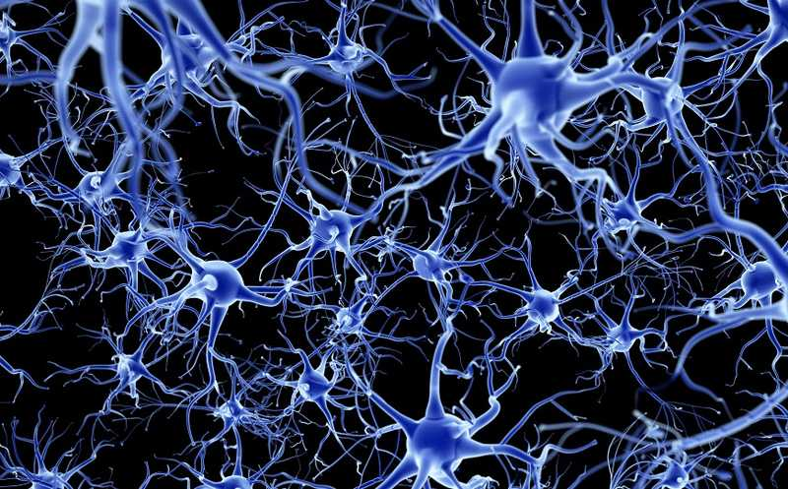
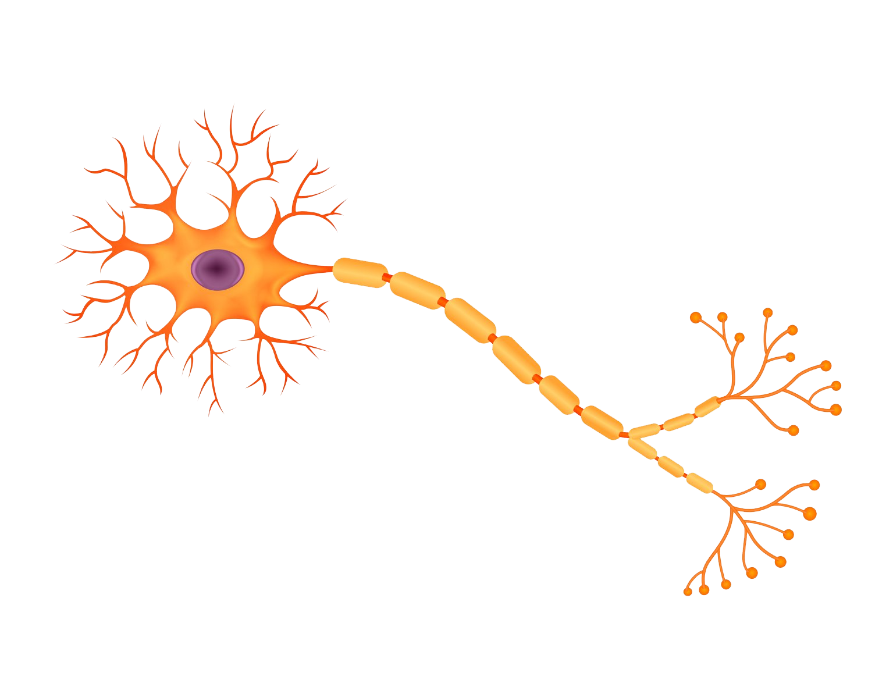
What are neural networks in nature?
Our brain is a giant neural network. It defines us. Neurons and the connections between them – define our personality, our consciousness, and our thinking. So it is logical that scientists try to copy this network to create AI.

Slide 3
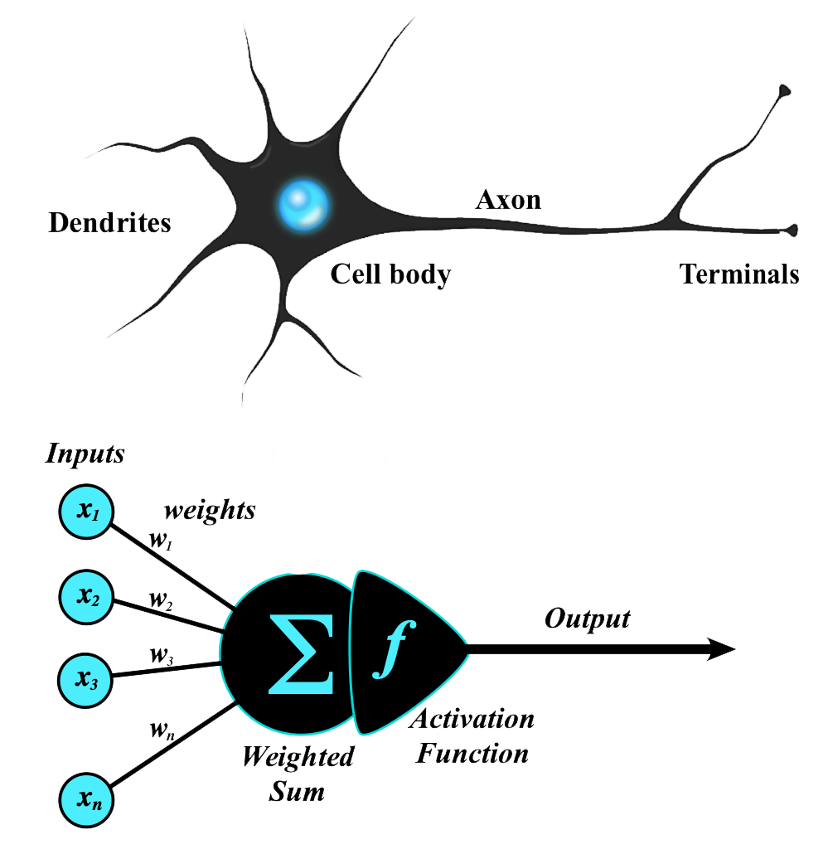
Logical Neuron

Slide 4
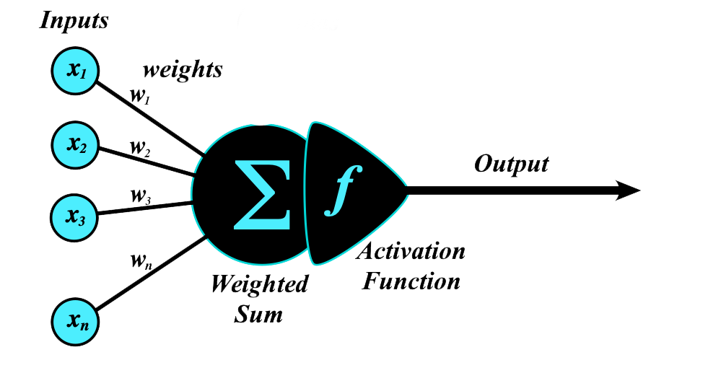
A neuron does the following:
  It receives several inputs.
  Each input has its own weight.
  The neuron multiplies each input by its weight and adds the results.
  Then it applies the activation function to this sum.
  After that it sends the result to its single output.
These weights are exactly what the model learns.

Slide 5
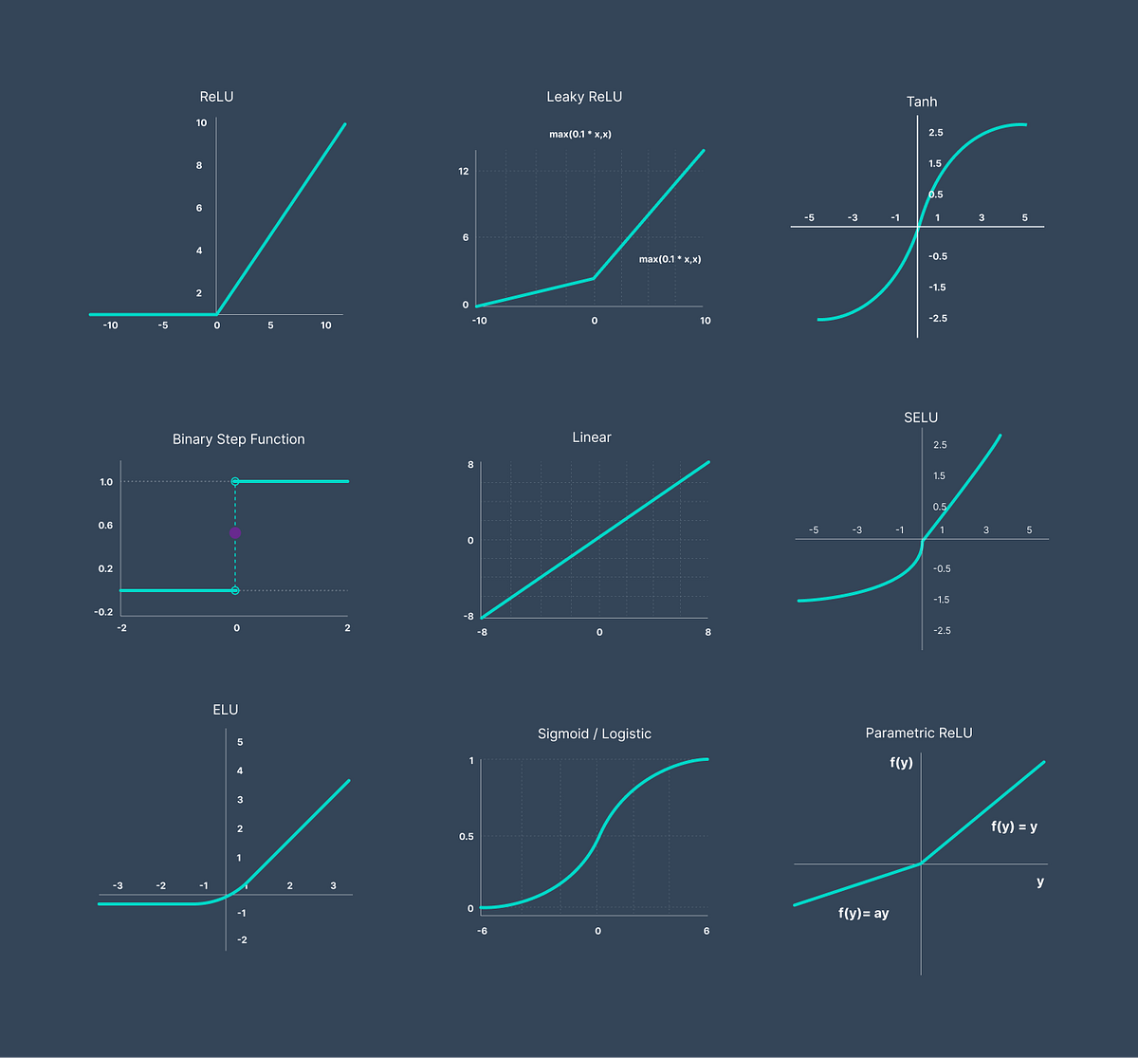
Activation Functions
* ReLU is the best

Slide 6
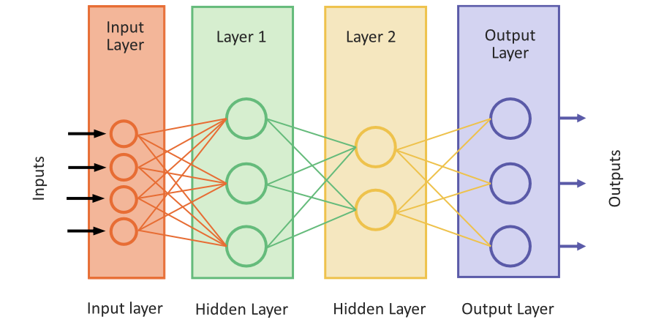
Neural Layers
Fully connected (Dense) Neural Network

Slide 7
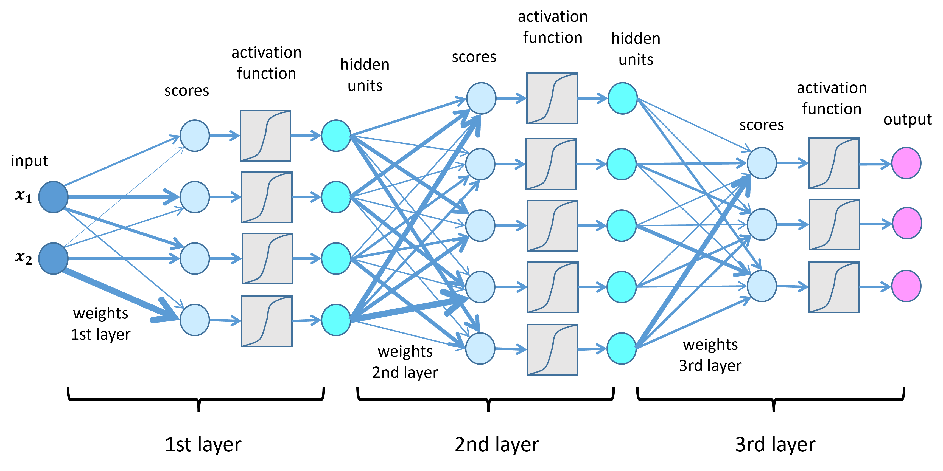
How does a neural network work?

Slide 8
Batches
Function of backpropogation of errors

Slide 9
The model (the network) receives input data in mini-batches. Each mini-batch contains several rows of the dataset. The size of batch – is very important hyperparameter of model.
The mini-batch is passed through the network according to the current weights, and at the output we obtain predictions of the target variable (for example, the price).
These predictions differ from the true values. Based on this difference (the loss), the network adjusts the weights of all neurons – so that future predictions become more accurate. Then the next mini-batch is taken, passed through the network, the predictions are compared with the real values, and the weights are adjusted again.
This cycle — “mini-batch → forward pass → loss → backpropagation → weight update” — for all data in the dataset called an epoch.
Training continues for many epochs, until the model finds weights that produce the best possible predictions.

Slide 10
In my code:
input_layer = Concatenate()(
[num_input, other_input])
x = Dense(128, activation="relu")(input_layer)
x = Dense(64, activation="relu")(x)
x = Dense(32, activation="relu")(x)
output = Dense(1)(x)

Slide 11
Advantages
Neural networks are suitable for a wide range of tasks. For example, in our project the neural network gives very good results (although, as expected, it is a little worse than XGBoosting).
Neural networks are very effective. They win most competitions on Kaggle.
Neural networks are very popular now. Deep learning networks are used in all large projects. All large companies, from Google to Facebook, use deep learning.

Slide 12
Disadvantages
Difficult to configure. I spent ten times more time and code for the neural network than for boosting.
You need to understand them: you need to understand their structure in order to configure them.
Very important disadvantage for business: neural networks are the black box.
They are completely unclear for customer. You newer cannot explain why the network produces a specific decision or directly control this decision.

Slide 13
Disadvantages
Difficult to configure. I spent ten times more time and code for the neural network than for boosting.
You need to understand them: you need to understand their structure in order to configure them.
For this you need advanced tensor mathematics. In the past, at university, people laughed at theoretical mathematicians. People asked: where will they work? Now theoretical mathematicians earn a lot of money in data science.
Very important disadvantage for business: neural networks are the black box.
They are completely unclear for customer. You newer cannot explain why the network produces a specific decision or directly control this decision.

Slide 14
Additional information
There is also some information that I used in our work with the dataset,
but I don’t describe it here, because it is impossible to cover everything.
Embedding for categorical variables
Early stopping (with splitting dataset into three parts)

Slide 15
Additional information
Embedding:
A way to represent an object (category) as a vector of numbers. Similar objects receive similar vectors (they are close to each other in this space). These vectors are used as regular numerical features for a neural network.
Early stopping:
A technique when you stop training before the model fully overfits.
The model is trained for multiple epochs, after each epochs, you compute the validation loss/metric. If the validation performance stops improving, training is stopped early.
The final model is taken from the epoch with the best validation performance, not from the last epoch.

Slide 16
Deep Learning and Neural Networks
Deep learning is a special case of neural networks, but it is treated as a separate type of ML
Main reasons why deep learning is considered a separate type of ML:
1. Significantly different depth and architectures
  Traditional neural networks were historically shallow: 1–2 hidden layers.
  Deep learning — hundreds of layers with a specific architecture
  2. Automatic feature extraction
  Classical ML: a human manually designs features.
  Deep learning: the model itself builds multi-level representations (features) from raw data (pixels, audio, text).
  3. Scale of data and computation
  Deep learning usually requires huge datasets and powerful GPU/TPU hardware.
4. Application areas
  Many of the recent breakthroughs (computer vision, machine translation, text/image generation) are driven specifically by deep learning.
  Therefore, in industry and literature it is often separated from “classical ML” and from just “neural networks” as a distinct direction.

Slide 17
Deep Learning and Neural Networks
Criterion | Traditional Neural Networks | Deep Learning
Network depth | 1–2 hidden layers | hundreds of layers
Architecture | Simple MLP | CNN, RNN, Transformers, etc.
Feature extraction | Manual feature engineering | Features are learned automatically
Complex tasks | Limited | Very high (vision, speech, text)
Data requirements | Can train on smaller datasets | Requires large datasets
Computational resources | CPU is usually sufficient | Requires GPU/TPU

Slide 18
Thank you for your attention

